Slide 1
Sketching Techniques for
Real-time Big Data
Bahman Bahmani
bahman@stanford.edu

Slide 2
Outline
Password Security [Schechter et al. ’10]
Semantic Analytics [Goyal et al. ’11]
Reputation Systems [Bahmani et al. ’11]
Conclusion

Slide 3
Outline
Password Security [Schechter et al. ’10]
Semantic Analytics [Goyal et al. ’11]
Reputation Systems [Bahmani et al. ’11]
Conclusion

Slide 4
Password selection policies
Length of 8 to 20
Both letters and numbers
Both lower and upper case letters
Non-alphanumeric characters
A number between first and last character
Not your dog’s name
…
Oh, by the way, change it once a month!

Slide 5
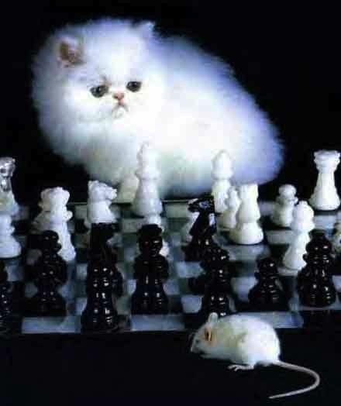
Unintended consequences
Rule | Consequence
Require minimum length | Use dictionary words, write down passwords
Include special characters | E→3, a→@,…
No simple character replacements | #→{lb, hash}, ^→{hat, top}, ...

Slide 6
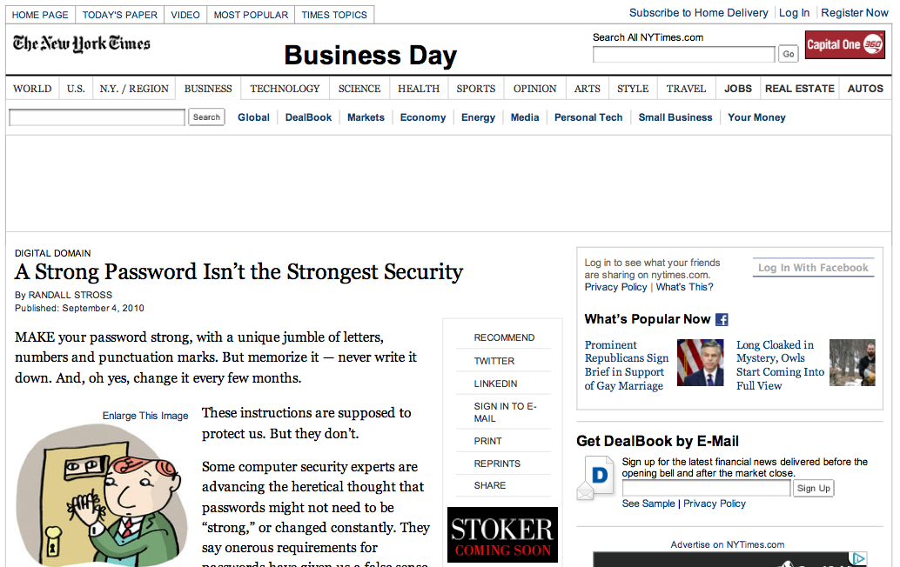
Strong password = security?

Slide 7
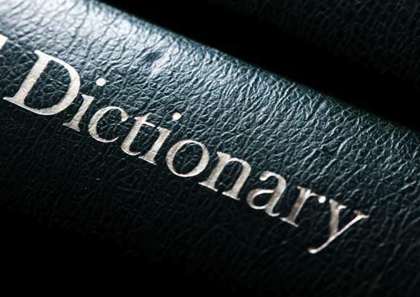
Why all these rules then?
Statistical guessing attacks

Slide 8
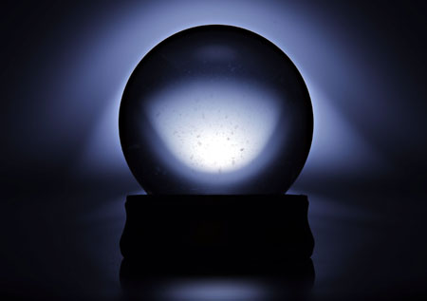
Why not just measure popularity?!
Popularity oracle: Map passwords to counts
If password popular, prompt user to change it
  Can limit attack to 0.0001% rather than 0.22% (MySpace) or 0.9% (RockYou)

Slide 9
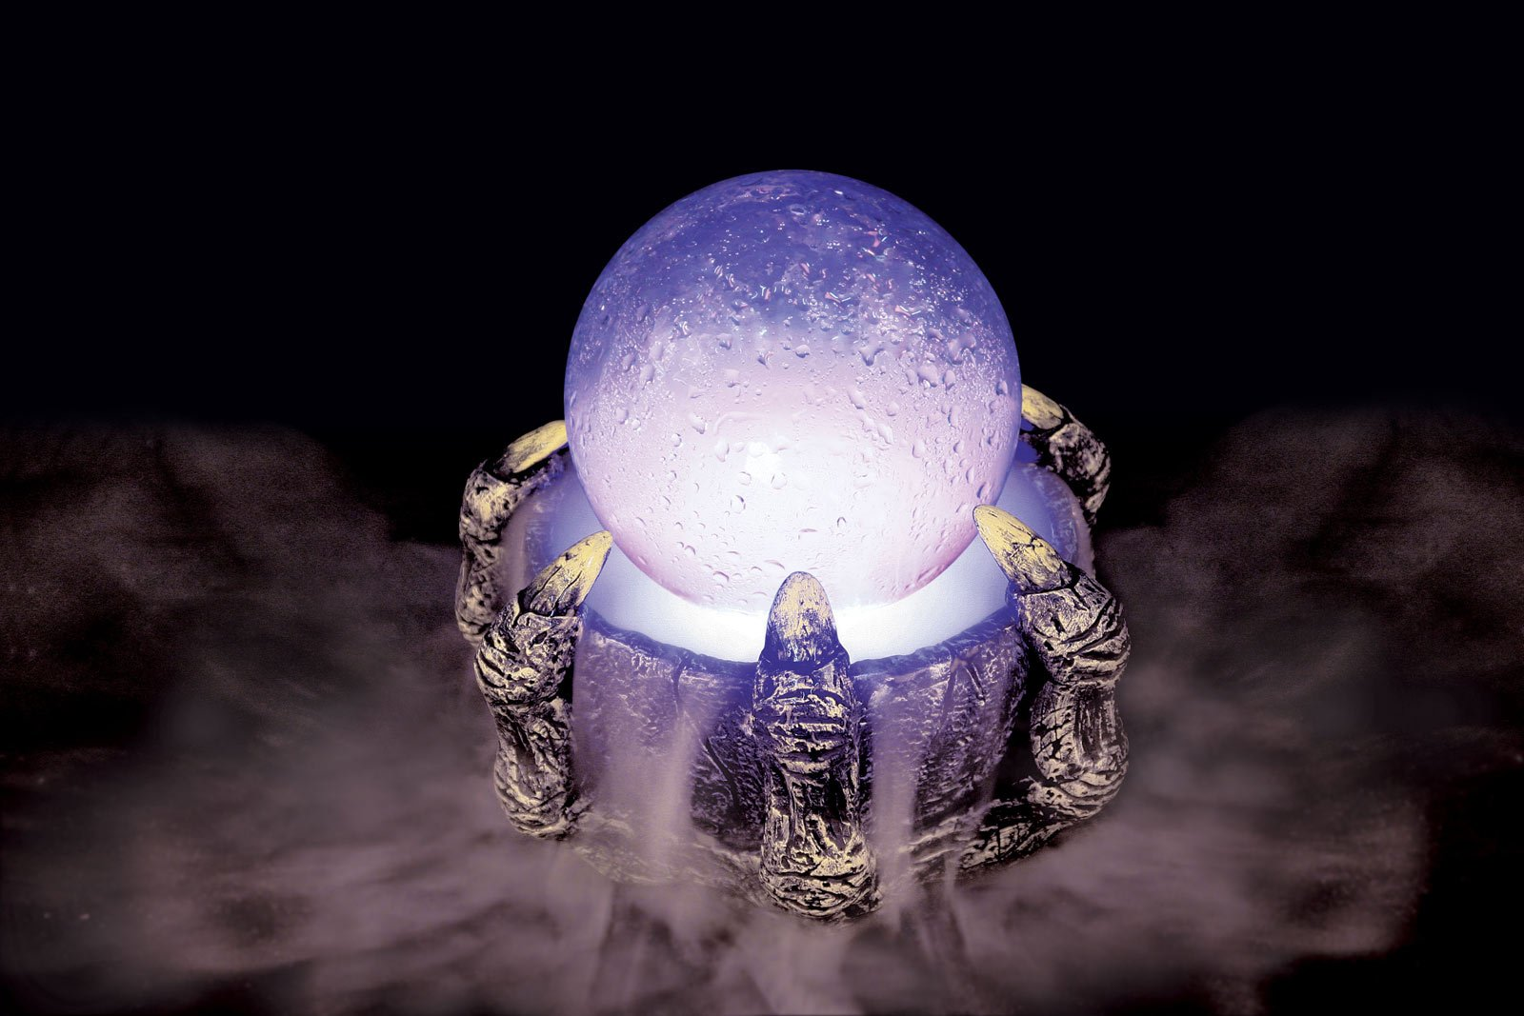
What is wrong with this oracle?
Allows no salting
If compromised, attack is optimized!

Slide 10
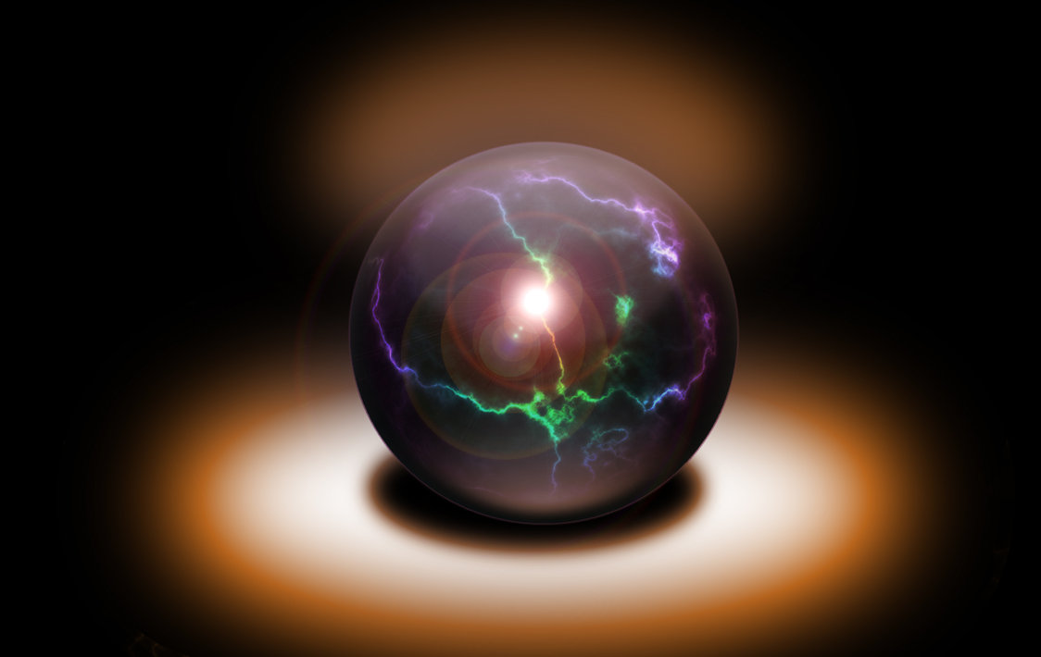
Requirements for a good oracle
Keep counts without keeping passwords
Quick updates
Quick queries

Slide 11
Candidate Magic oracle
0 | 0 | . . . | 0 | 0 | 0
0 | 0 | . . . | 0 | 0 | 0
 |  | . . .
0 | 0 | . . . | 0 | 0 | 0
.
.
.
.
.
.
.
.
.
d
.
.
.
.
.
.
w

Slide 12
CM oracle
0 | 0 | . . . | 0 | 0 | 0
0 | 0 | . . . | 0 | 0 | 0
 |  | . . .
0 | 0 | . . . | 0 | 0 | 0
.
.
.
.
.
.
.
.
.
d
.
.
.
.
.
.
w

Slide 13
CM oracle
0 | 0 | . . . | 0 | 1 (=0+1) | 0
0 | 1 (=0+1) | . . . | 0 | 0 | 0
 |  | . . .
1 (=0+1) | 0 | . . . | 0 | 0 | 0
.
.
.
.
.
.
.
.
.
d
.
.
.
.
.
.
w

Slide 14
CM oracle
0 | 0 | . . . | 0 | 1 (=0+1) | 0
0 | 1 (=0+1) | . . . | 0 | 0 | 0
 |  | . . .
1 (=0+1) | 0 | . . . | 0 | 0 | 0
.
.
.
.
.
.
.
.
.
d
.
.
.
.
.
.
w

Slide 15
CM oracle
0 | 0 | . . . | 0 | 1 (=0+1) | 0
0 | 1 (=0+1) | . . . | 0 | 0 | 0
 |  | . . .
1 (=0+1) | 0 | . . . | 0 | 0 | 0
.
.
.
.
.
.
.
.
.
d
.
.
.
.
.
.
w

Slide 16
CM oracle
1 (=0+1) | 0 | . . . | 0 | 1 (=0+1) | 0
0 | 1 (=0+1) | . . . | 1 (=0+1) | 0 | 0
 |  | . . .
1 (=0+1) | 1 (=0+1) | . . . | 0 | 0 | 0
.
.
.
.
.
.
.
.
.
d
.
.
.
.
.
.
w

Slide 17
CM oracle
1 (=0+1) | 0 | . . . | 0 | 1 (=0+1) | 0
0 | 1 (=0+1) | . . . | 1 (=0+1) | 0 | 0
 |  | . . .
1 (=0+1) | 1 (=0+1) | . . . | 0 | 0 | 0
.
.
.
.
.
.
.
.
.
d
.
.
.
.
.
.
w

Slide 18
CM oracle: how about collisions?
1 (=0+1) | 0 | . . . | 0 | 1 (=0+1) | 0
0 | 1 (=0+1) | . . . | 1 (=0+1) | 0 | 0
 |  | . . .
1 (=0+1) | 1 (=0+1) | . . . | 0 | 0 | 0
.
.
.
.
.
.
.
.
.
d
.
.
.
.
.
.
w

Slide 19
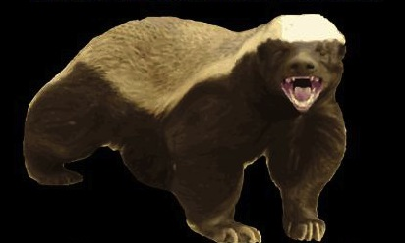
CM oracle don’t care!

Slide 20
CM oracle
2 (=0+1+1) | 0 | . . . | 0 | 1 (=0+1) | 0
0 | 2 (=0+1+1) | . . . | 1 (=0+1) | 0 | 0
 |  | . . .
1 (=0+1) | 1 (=0+1) | . . . | 1 (=0+1) | 0 | 0
.
.
.
.
.
.
.
.
.
d
.
.
.
.
.
.
w

Slide 21
CM oracle
2 (=0+1+1) | 0 | . . . | 0 | 1 (=0+1) | 0
0 | 2 (=0+1+1) | . . . | 1 (=0+1) | 0 | 0
 |  | . . .
1 (=0+1) | 1 (=0+1) | . . . | 1 (=0+1) | 0 | 0
.
.
.
.
.
.
.
.
.
d
.
.
.
.
.
.
w

Slide 22
CM oracle
2 (=0+1+1) | 0 | . . . | 0 | 1 (=0+1) | 0
0 | 2 (=0+1+1) | . . . | 1 (=0+1) | 0 | 0
 |  | . . .
1 (=0+1) | 1 (=0+1) | . . . | 1 (=0+1) | 0 | 0
.
.
.
.
.
.
.
.
.
d
.
.
.
.
.
.
w

Slide 23
CM oracle
2 (=0+1+1) | 0 | . . . | 0 | 2 (=0+1+1) | 0
0 | 3 (=0+1+1+1) | . . . | 1 (=0+1) | 0 | 0
 |  | . . .
2 (=0+1+1) | 1 (=0+1) | . . . | 1 (=0+1) | 0 | 0
.
.
.
.
.
.
.
.
.
d
.
.
.
.
.
.
w

Slide 24
CM oracle
2 | 0 | . . . | 0 | 2 | 0
0 | 3 | . . . | 1 | 0 | 0
 |  | . . .
2 | 1 | . . . | 1 | 0 | 0
.
.
.
.
.
.
.
.
.
d
.
.
.
.
.
.
w

Slide 25
CM oracle query: Minimum counter
2 | 0 | . . . | 0 | 2 | 0
0 | 3 | . . . | 1 | 0 | 0
 |  | . . .
2 | 1 | . . . | 1 | 0 | 0
.
.
.
.
.
.
.
.
.
d
.
.
.
.
.
.
w

Slide 26
CM oracle: Theorem
Choosing d,w “properly” leads to “tiny” errors in frequencies with “very large” probability
Formally, at most ε error with probability 1-δ:

Slide 27
CM oracle: Example
With w=270,000 and d=14, error in frequencies less than 10⁻⁵ = 0.00001 with probability 1-10⁻⁶ = 0.999999!

Slide 28
CM oracle: Magic
Guarantee independent of number of passwords
Example: Fit (approximate) counts of 100M passwords in less than 4M counters!

Slide 29
What if CM oracle is stolen?
Choose d and w small enough to ensure a minimum false positive rate!
Trouble users just a little bit, but confound attackers

Slide 30
CM oracle sketch
Small memory
  remember only what matters
Quick updates
Quick queries
That’s the definition of a sketch

Slide 31
Simple examples
Stream of numbers a₁, a₂, …, a_{t}, …
SUM sketch: running sum
AVG sketch: (running sum, count)

Slide 32
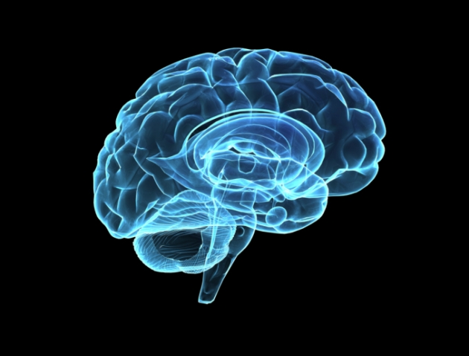
Cognitive Analogy
Stream of sensory observations
Remember only parts of observations
Still function properly
Everyone is doing it! [Muthukrishnan, 2005]

Slide 33
Outline
Password Security [Schechter et al. ’10]
Semantic Analytics [Goyal et al. ’11]
Reputation Systems [Bahmani et al. ’11]
Conclusion

Slide 34

Example: Sentiment Analysis
Is a word used more in a positive or a negative sense?

Slide 35

Problem: Positive or negative?
**myPhone***
myPhone**great*
*myPhone*****terrible
***nice***
*myPhone***
**excellent**myPhone***
** bad **** **myPhone **
myPhone**good*

Slide 36
Solution: Co-occurrence counts
myPhone and words good, great, nice, ...
myPhone and words bad, awful, terrible, …

Slide 37
Co-occurrence counts applications
Statistical machine translation
Spelling correction
Part-of-speech tagging
Paraphrasing
Word sense disambiguation
Language modeling
Speech and character recognition
…

Slide 38
Co-occurrence counts task
Large corpus of documents
  Tweet stream
  Web corpus
Vocabulary {w₁,w₂,…,w_{N}}
  English language: N≈10⁵
  Web: N≈10⁹
Goal: For any two words in the vocabulary, compute the number of documents containing both

Slide 39
Problem: Too many unique pairs
Example [Goyal et al., 2010]:
  78M word corpus of size 577MB
  63K unique words
  118M unique word pairs, 2GB to only store them

Slide 40
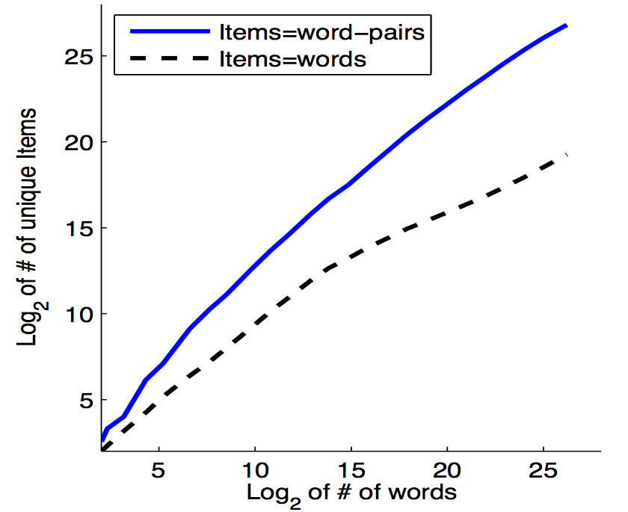
It gets worse with larger corpus size

Slide 41

Solution 1: Just Hadoop it!
Compute all co-occurrence counts exactly
  Ref. [“Data-Intensive Text Processing with MapReduce”, Lin et al.]
Problem: Too inefficient

Slide 42
Solution 2: CM sketch
Use a CM sketch to track the counts of word pairs

Slide 43
Example
0 | 0 | . . . | 0 | 0 | 0
0 | 0 | . . . | 0 | 0 | 0
. . . | . . . | . . . | . . . | . . . | . . .
0 | 0 | . . . | 0 | 0 | 0
d
w

Slide 44
Example
How do you shoot a yellow elephant?
(shoot, yellow)
0 | 0 | . . . | 0 | 0 | 0
0 | 0 | . . . | 0 | 0 | 0
. . . | . . . | . . . | . . . | . . . | . . .
0 | 0 | . . . | 0 | 0 | 0
d
w

Slide 45
Example
How do you shoot a yellow elephant?
(shoot, yellow)
0 | 1 | . . . | 0 | 0 | 0
0 | 0 | . . . | 1 | 0 | 0
. . . | . . . | . . . | . . . | . . . | . . .
1 | 0 | . . . | 0 | 0 | 0
(shoot, elephant)
d
w

Slide 46
Example
How do you shoot a yellow elephant?
(shoot, yellow)
0 | 1 | . . . | 1 | 0 | 0
0 | 1 | . . . | 1 | 0 | 0
. . . | . . . | . . . | . . . | . . . | . . .
2 | 0 | . . . | 0 | 0 | 0
(shoot, elephant)
d
(yellow, elephant)
w

Slide 47
Example
How do you shoot a yellow elephant?
(shoot, yellow)
0 | 2 | . . . | 1 | 0 | 0
0 | 1 | . . . | 1 | 0 | 1
. . . | . . . | . . . | . . . | . . . | . . .
2 | 0 | . . . | 1 | 0 | 0
(shoot, elephant)
d
(yellow, elephant)
w

Slide 48
Back to sentiment analysis
Query the CM sketch with the pairs
  (myPhone, good)
  (myPhone, nice)
  (myPhone, bad)
  (myPhone, terrible)
  …

Slide 49
CM sketch: Gain
Does not store the word pairs themselves
30X less space (37GB corpus, almost no error) [Goyal et al., 2010]

Slide 50
Outline
Password Security [Schechter et al. ’10]
Semantic Analytics [Goyal et al. ’11]
Reputation Systems [Bahmani et al. ’11]
Conclusion

Slide 51
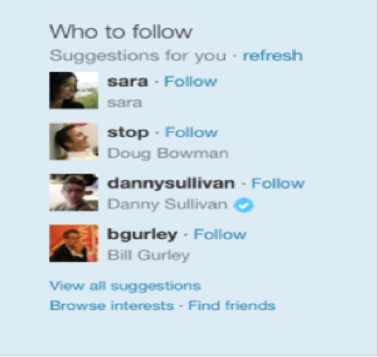
Motivation

Slide 52
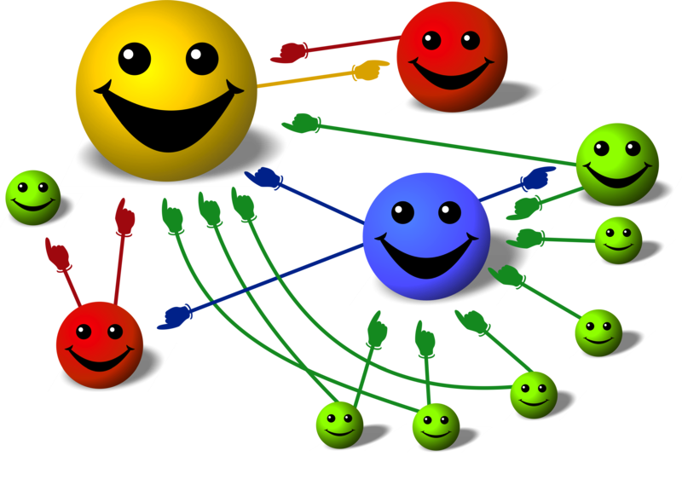
PageRank
Well known reputation system [Page et al., 1998]
Treats each link as an endorsement
A node highly reputed if endorsed by many other such nodes

Slide 53
Goal: Computing PageRank on the fly
Network edges arrive over time
  Friendships
  Social events
Maintain an accurate estimate of PageRank of every node after each edge arrival

Slide 54
Random surfer interpretation
A random surfer traverses the network
  Teleports to a completely random node with some probability ε (e.g., ε=0.2) at each step
  Follows a random link otherwise
PageRank: stationary distribution of this walk

Slide 55
Example: Random surfer
2
3
4
10
9
1
5
6
8
11
7

Slide 56
Example: Random surfer
2
3
4
10
9
1
5
6
8
11
7

Slide 57
Example: Random surfer
2
3
4
10
9
1
5
6
8
11
7

Slide 58
Example: Random surfer
2
3
4
10
9
1
5
6
8
11
7

Slide 59
Example: Random surfer
2
3
4
10
9
1
5
6
8
11
7

Slide 60
Example: Random surfer
2
3
4
10
9
1
5
6
8
11
7

Slide 61
PageRank computation methods
Power Iteration: Iterative linear algebraic method.
Monte Carlo: Simulate the PageRank walk. Use the empirical distribution to approximate PageRank.
Neither can be done efficiently on the fly

Slide 62
PageRank sketch
Store R random walks starting at each node
Whenever a new edge arrives modify only the random walks needing an update
  New edge (u, v)
  Only walks passing through u
  Each with probability 1/degree(u)

Slide 63
Example
 | Node 1 | Node 2 | Node 3
1 | 12123212 | 2 | 323232
2 | 123211123232 | 2112321112323 | 32
3 | 11 | 23 | 3232321
4 | 1111 | 2323211112321 | 32323
5 | 1121111 | 2 | 3212321232321
6 | 12323 | 2323212 | 3
7 | 1 | 2111 | 3232121112321
8 | 12123 | 232121112 | 3212
9 | 11 | 2 | 3
10 | 111212111232 | 211121121 | 321121
1
3
2

Slide 64
Example
 | Node 1 | Node 2 | Node 3
1 | 13212 | 2 | 323232
2 | 1321321 | 21232321 | 32
3 | 11111 | 23 | 3232321
4 | 13 | 23 | 32323
5 | 113213211321 | 2 | 321232323
6 | 12323 | 2323212 | 3
7 | 1 | 232 | 3232121112321
8 | 1 | 232121112 | 32
9 | 1323 | 2 | 3
10 | 1321 | 2 | 321121
1
3
2

Slide 65
Key Insight
Most edges miss most random walks!
Even more pronounced as network grows larger.

Slide 70
PageRank sketch: Theorem
As the network grows, the marginal number of operations per update decreases!
Theorem: Given random arrivals, if M_{t} is the update work at time t

Slide 71
Outline
Password Security [Schechter et al. ’10]
Semantic Analytics [Goyal et al. ’11]
Reputation Systems [Bahmani et al. ’11]
Conclusion

Slide 72
Sketching: Why Care?
Different view of big data analysis
Nimble and on the fly, compared to bulky and inefficient
Direct reduction in data infrastructure costs, both CAPEX and OPEX

Slide 73
Sketching: How about errors?
Mathematical guarantees behind rates and sizes of errors
If you can not make a decision based on an analytics result, which has less than 0.0001% error with probability 0.99999, then you most likely should not make that decision!

Slide 74
Sketching: What’s next?
Lots of applications:
  Security, Social media analytics, Recommendation systems, Sensor networks, Intelligent mobile applications
The math and algorithms are there
Needed:
  Technologists: build systems with sketching techniques
  Entrepreneurs: build products with these techniques
  Big business leaders: learn about, adopt, and benefit from these techniques

Slide 75
Thanks!
Get in touch:
  Office Hour, 2:20pm
  bahman@stanford.edu

Slide 76
Appendix: Photo Credits
Slide 4: http://www.the-games-blog.com/and-the-cat-and-mouse-game-continues/
Slide 6: http://www.security-faqs.com/what-exactly-is-a-dictionary-attack.html
Slide 7: http://krepon.armscontrolwonk.com/archive/3182/forecasting-proliferation/crystalball-2
Slide 8: http://www.hdwallpaperspics.com/crystal-ball-wallpapers.html
Slide 9,27, 41, 48: http://lissarankin.com/do-you-expect-people-to-read-your-mind
Slide 18: http://ouroregon.org/category/content-authors/alina-harway?page=2
Slide 31: http://sciencesoup.tumblr.com/post/39608896216/learning-foreign-languages-triggers-brain
Slide 33: http://livingqlikview.blogspot.com/2012/03/my-sentiments-on-sentiment-analysis.html
Slide 34: http://www.presentermedia.com/index.php?target=closeup&maincat=clipart&id=2221
Slide 40: http://www.clker.com/clipart-yellow-elephant.html
Slide 51: http://en.wikipedia.org/wiki/PageRank

